Slide 1


CompSci club
Review & discussion of last year
Welcome back! It is so amazing to see you again, and hello to our new members!

Slide 2

Our person of the day!
Craig Federighi
Tomorrow, Apple will have their annual Apple Event
One of the conference’s most popular figures over the years has been Craig Federighi, the senior vice president of software engineering at the company
Craig received his degree from UC Berkeley and would work under Steve Jobs at NeXT
He would rejoin Apple in 2009 to lead their macOS engineering and would take on the iOS responsibilities three years later
Craig’s team is responsible for the interfaces, applications and frameworks Apple provides!
He would be present at numerous Apple events, dating back to 2009, but he would become famous for his appearance in 2020 — people have loved his energetic personality ever since!
Software Engineer at Apple

Slide 3
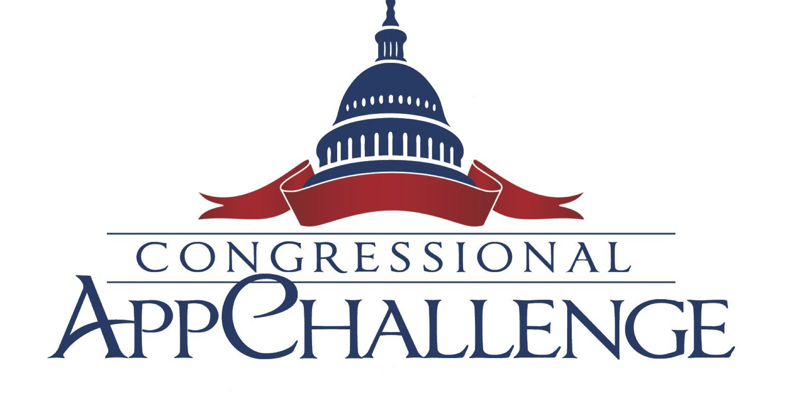
Opportunities Board
This is something that we will do periodically, or as frequently we get chances to show you things!
These are upcoming CS events or activities that we think you might enjoy — usually they will have something for all experience levels
Currently, the Congressional App Challenge is running, which is a fantastic opportunity to design and even build apps to display to the local community and even the entire U.S.!
No prior coding experience is required to participate and you can find resources for challenge in the speaker notes!
The deadline is October 1st!
Notes:
Some resources to help you!
https://ross.house.gov/services/congressional-app-challenge
https://www.congressionalappchallenge.us/students/rules/

Slide 4


Roadmap for Today
Discussion about Review
We just want to gauge about how much review and what we need to review!
Review Project
A project going over hopefully much what you learned last year!

Slide 5
We gotta be honest
Review
Discussion

Slide 6
Notes about CS club
We recognize last year at some parts it seemed that we were just going in circles
Our principal goal with Track Two (and the club as a whole) is to do more coding than ever and most of all, do coding that you enjoy
Thank you for those that filled out the survey at the interest meeting last week — it has been a tremendous help
For those who didn’t, and you would like to say something that you want to see CS Club do or feedback based on last year, please feel free to speak up!
In order to advance this goal of being more efficient, we want to know which aspects of CS Club that you need the most help with or review so we don’t spend too much time doing things you all already know

Slide 7
Topics from CS Club last year
Loops
GitHub & Version Control
List Comprehension
Functions
Classes

Slide 8
Note: SUbject to change!
Recap
Project

Slide 9
Recap Project
We have prepared a recap project for you all that encapsulates much of what we went over last year, from the basics to more advanced topics
Based off our discussion for today, we can adapt it so you are all practicing skills you feel most vital to review
Furthermore, if you feel like this recap project is dumb or unneeded, let us know! We would be more than happy to scrap it next week and launch into a new topic
However, we know that for some of you this may feel like a much needed refresher, so that is why we prepared it
As always, let us know if the instructions are unclear if you have any questions!

Slide 10
If you have any questions at all, please don’t hesitate to stay back or email one of us!
Thank you!
That is all we have for today!

